Slide 1
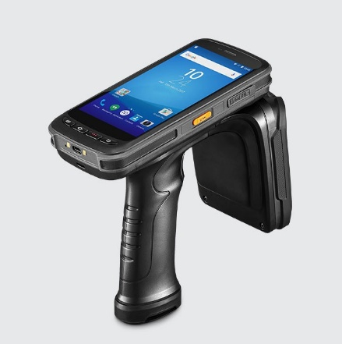
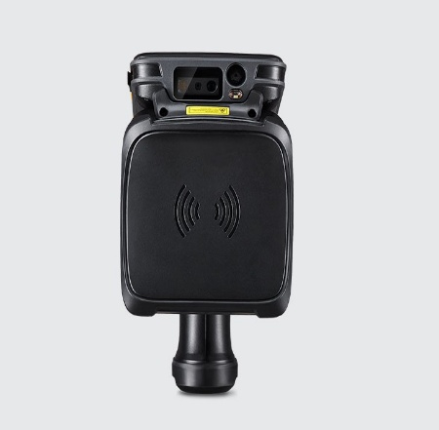
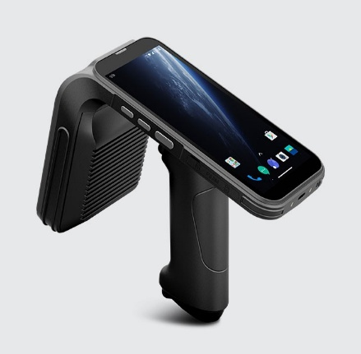
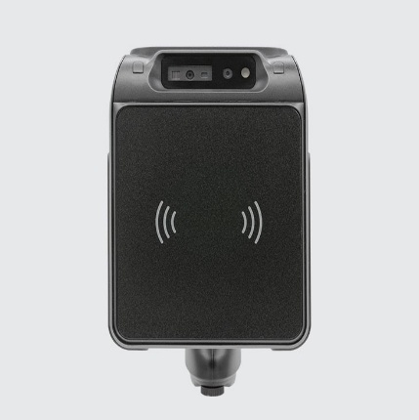
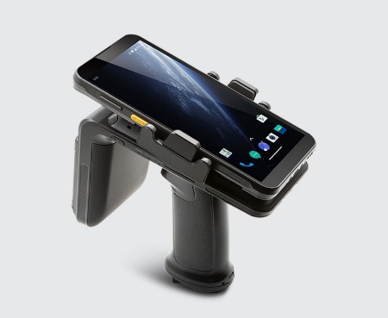
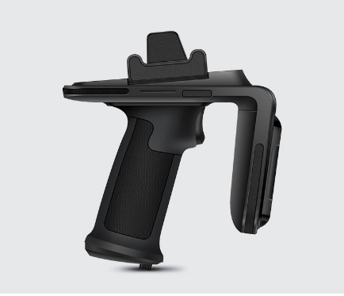
RFIDHandheld Readers
C72-READER
Key Specifications
C72 Hand Held Reader
Frequency Band: UHF (860-960)
Polarisation : Circular
Read range : long range upto 10 Meters
Read capacity : 1100 tags/sec
Application : Inventory management, Retail, WMS and more.
Main Features : UHF RFID, NFC, 1D/2D
MOQ : 1
Price : 52000/-
C5-READER
Key Specifications
C5 Hand Held Reader
Frequency Band: UHF (860-960)
Polarisation : Circular
Read range : long range upto 10 Meters
Read capacity : 1100 tags/sec
Application : Item level traceability, Inventory management, Retail, WMS ..
Main Features : Gen2X Compliant, UHF RFID, NFC, 1D/2D
MOQ : 1
Price : 47000/-
R6-READER
Key Specifications
R6 Hand Held Sled Reader
Frequency Band: UHF (860-960)
Polarisation : Circular
Read range : long range upto 6 Meters
Read capacity : 900 tags/sec
Application : Item level traceability, Inventory management, Retail, WMS ..
Main Features : Gen2X Compliant, UHF RFID, NFC, 1D/2D
MOQ : 1
Price : 35000/-
7042436155
www.aetherrfid.com

Slide 2
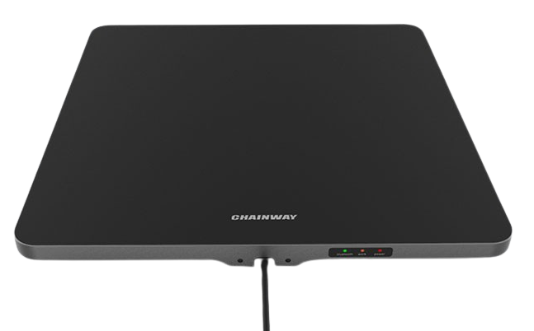
RFID Fixed/Desktop Readers
URA4 Fixed-READER
Key Specifications
URA4 Fixed 4 Port Reader
Frequency Band: UHF (860-960)
Operating System : Android 9
Read range : long range upto 15 Meters
Read capacity : 900+ tags/sec
Application : Inventory management, Retail, WMS and more.
Main Features : Impinj Module, 4 Port Reader, Port Extension, Android Based, Direct Data Transfer
Price : 60000/-
U300 Fixed-READER
Key Specifications
U300 Fixed 4/8 Port Reader – Gen2X
Frequency Band: UHF (860-960)
Operating System : Android 11
Read range : long range upto 15 Meters
Read capacity : 1300+ tags/sec
Application : Inventory management, Retail, WMS and more.
Main Features : Impinj Module, 4 Port Reader, Port Extension, Android Based, Direct Data Transfer
Price : 68000/-
R3 Fixed-READER
Key Specifications
Desktop Reader – Gen2X
Frequency Band: UHF (860-960)
Operating System : Android 11
Read range : long range upto 15 Meters
Read capacity : 1300+ tags/sec
Application : Inventory management, Retail, WMS and more.
Main Features : Impinj Module, 4 Port Reader, Port Extension, Android Based, Direct Data Transfer
Price : 35000/-
7042436155
www.aetherrfid.com

Slide 3
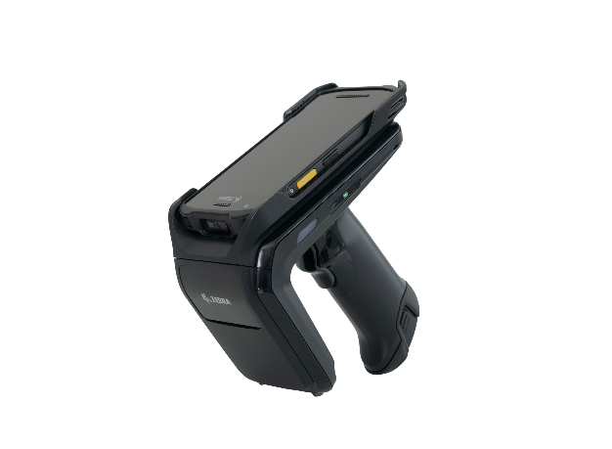
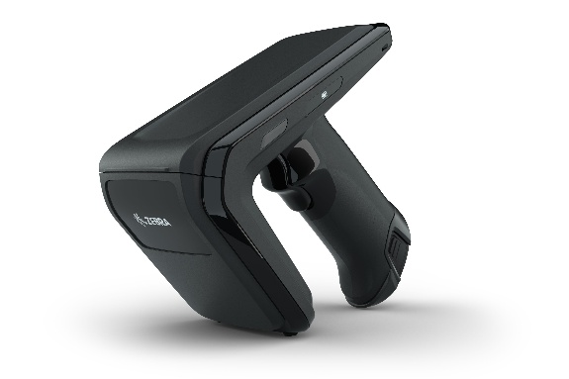
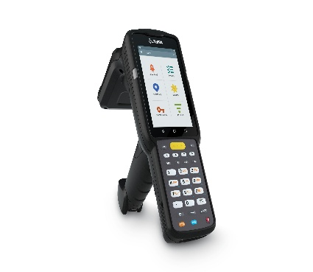
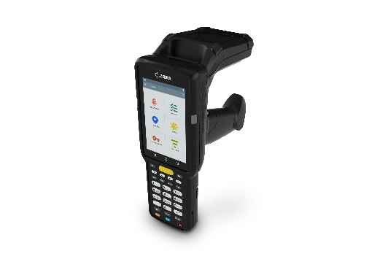
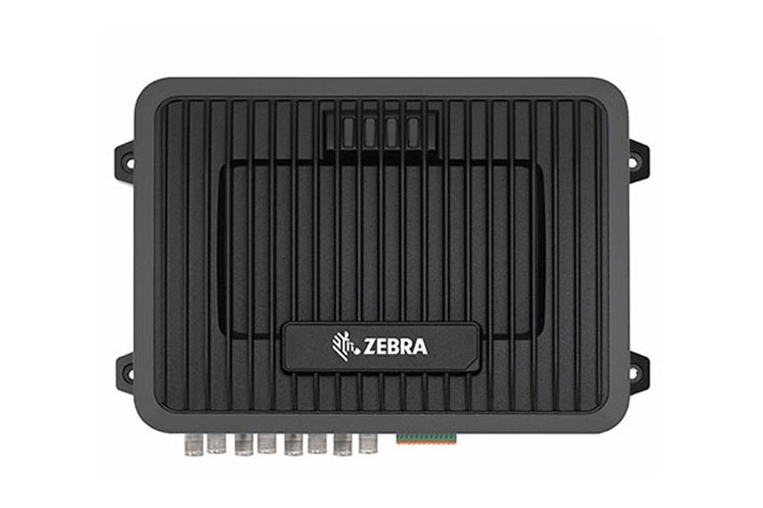
RFIDHandheld Readers
RFD40-READER
Key Specifications
RFD40 Hand Held Sled Reader
Frequency Band: UHF (860-960)
Polarisation : Circular
Read range : long range upto 10 Meters
Read capacity : 600 tags/sec
Application : Inventory management, Retail, WMS and more.
Main Features : UHF RFID, NFC, 1D/2D
MOQ : 1
Price : 62000/-
MC3330XR-READER
Key Specifications
MC3330XR Held Reader – With Android 14
Frequency Band: UHF (860-960)
Polarisation : Circular
Read range : long range upto 8 Meters
Read capacity : 900 tags/sec
Application : Item level traceability, Inventory management, Retail, WMS ..
Main Features : UHF RFID,1D/2D, Screen with keypad high performance
MOQ : 1
Price : 137000/-
FX9600-READER
Key Specifications
FX9600 Fixed 4/8 port Reader
Max Receiver Sensitivity: -86 dBm monostatic
Operating Temperature: -4°F to 131°F (-20°C to 55°C)
Read range : long range upto 12 Meters
Read capacity : 1100 tags/sec
Application : Item level traceability, Inventory management
MOQ : 1
Price : 75000/-
7042436155
www.aetherrfid.com

Slide 4
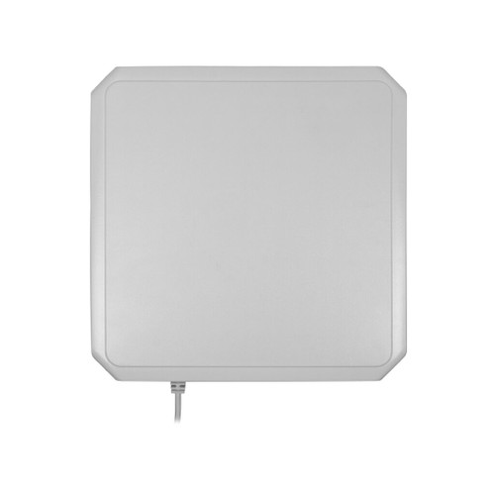
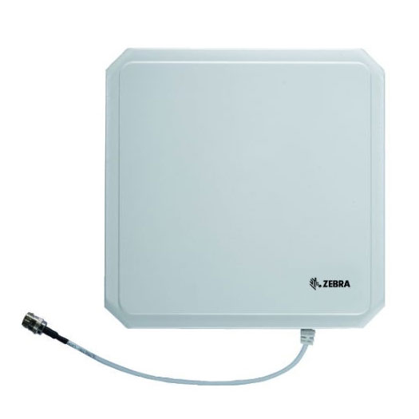
RFID Fixed/Desktop Readers
UHF READER Antenna
Key Specifications
Aether Long Range 9 dBi Antenna
Frequency Band: UHF (860-960)
Polarization : Circular
Read range : long range upto 12 Meters
Application : Inventory management, Retail, WMS and more.
Main Features : In-house designed, ABS Body, Long range, High performance
Price : 6000/-
UHF READER Antenna-AN480
Key Specifications
Zebra Long Range 9 dBi Antenna
Frequency Band: UHF (860-960)
Polarization : Circular
Read range : long range upto 12 Meters
Application : Inventory management, Retail, WMS and more.
Main Features : Zebra, ABS Body, Long range, High performance
Price : 12000/-
Aether Long Range Integrated -READER
Key Specifications
Long Range Reader with 12 dbi gain
Frequency Band: UHF (860-960)
Polarisation : Circular
Read range : upto 25 Meters
Read capacity : 1000 tags/sec
Application : Parking, Toll Plaza
Interface : RS232, RS485, Wiegand, POE
Price : 17000/-
7042436155
www.aetherrfid.com

